Slide 1
Special Education Data Updates
ESS Data Management
March 2025

Slide 2
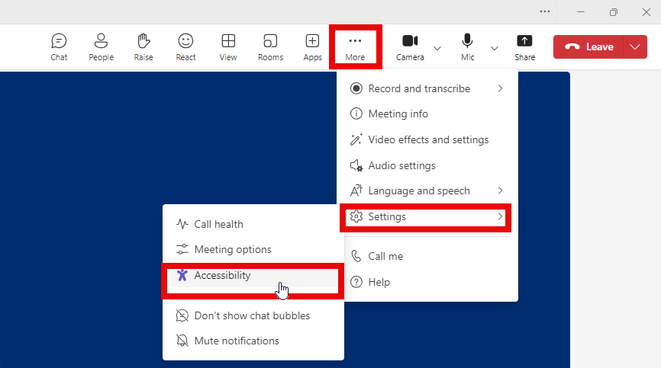
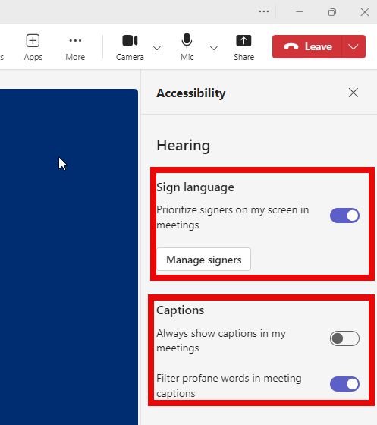
Before we get started, here are a few reminders:
To use live captions in Teams, go to the meeting controls at the top of the screen and select More > Settings > Accessibility
In the Accessibility options, you can manage how you view the signers (interpreters), if applicable, and turn on captions
Please stay muted throughout the presentation
There will be a Q&A session at the end
We will post this webinar recording on the ESS Data Management SEDU page
The use of AI meeting assistants, such as Otter.ai and Chorus.ai, that record audio of the meeting, write notes, capture action items, and generate meeting summaries for virtual meetings is prohibited.

Slide 3
Agenda
Reminders
Trending Topics
Top 3 Integrity Errors
SPED Reports 101
Out-of-Scope Topics
Q&A

Slide 4
Reminders
Special Education Data Updates

Slide 5
Upcoming Data Requirements
Parent Involvement Survey is currently underway and due by May 31
Contact: essparentsurvey@azed.gov
February 19, 2025 Webinar Recording
SOA opens April 2 and will be due June 11
Please visit our Important Dates webpage for a list of upcoming data reporting deadlines.

Slide 6
Trending Topics
Special Education Data Updates

Slide 7
FY 2026 Statement of Assurances (slide 1 of 2)
Required annually under IDEA
Public Education Agencies (PEAs)
Regardless of federal funds
Submitted before FY26 IDEA funding applications are approved by GME:
Superintendent
Charter Holder
Special Education Director

Slide 8
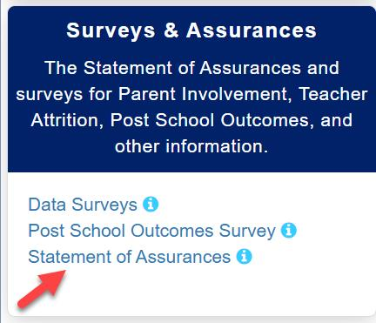
FY 2026 Statement of Assurances (slide 2 of 2)
ADEConnect
Role = ESS Special Education: Signer
ESS Portal

Slide 9
Preschool Outcomes (slide 1 of 2)
Data reporting requirements
Assessment Period
Assessment Category
Positive social-emotional skills
Acquisition and use of knowledge and skills
Use of appropriate behaviors to meet their needs
Outcomes of assessment

Slide 10
Preschool Outcomes (slide 2 of 2)
Preschool Outcome Integrity errors:
-40087
-40088
-40089
Updates for new FY
For FY26, if a PEA is failing one of these integrity errors, they will now fail integrity and will cause the student to fall off the SPED07 report for October 1.

Slide 11
SPED Reports 101
Special Education Data Updates

Slide 12
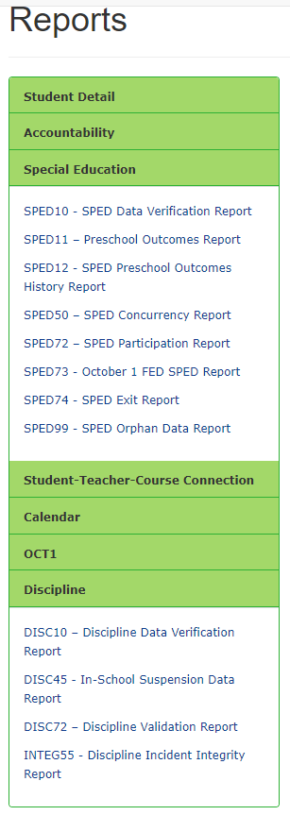
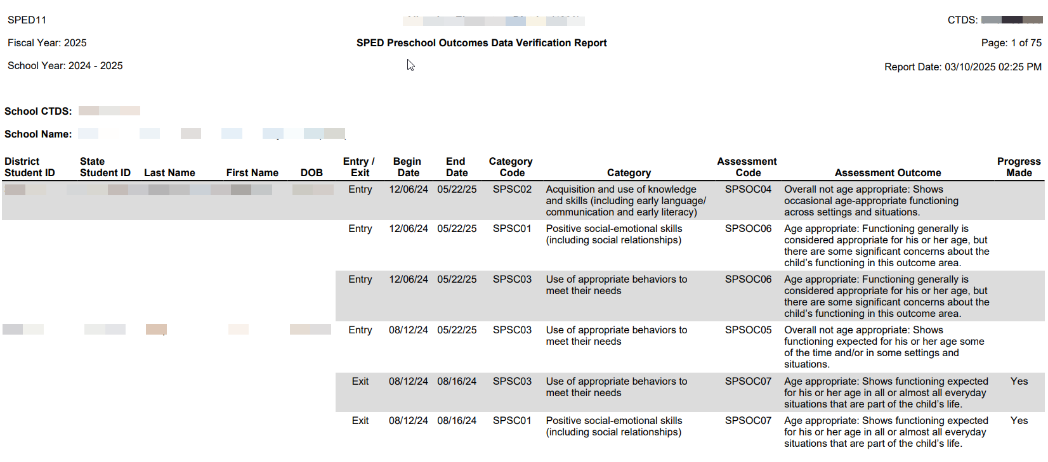
SPED11: Preschool Outcomes Report
This report provides a compilation of student SPED Preschool Outcomes data that has been submitted to ADE.

Slide 13
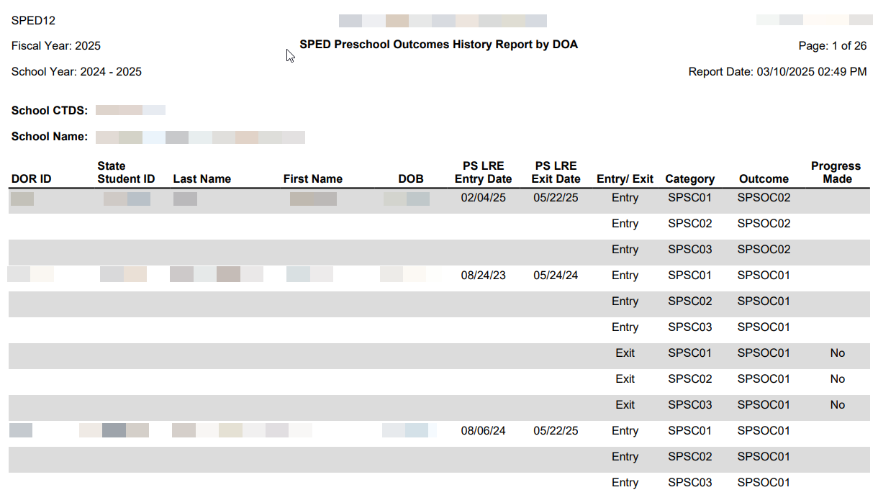
SPED12: Preschool Outcomes History Report
This report provides a history of Preschool up to the last enrollment reported by the entity viewing the report.

Slide 14
SPED Reports 101 Resource
Guide to all reports related to Special Education
SPED Report 101 Document
Found on the ESS Data Management website
AzEDS SPED Reporting
Tools and Resources

Slide 15
How Do I Get Access to SPED Reports?
You must have an ADEConnect account
Request the AzEDS Data Coordinator: SPED Reports role from your local ADEConnect Entity Administrator to view AzEDS Reports
Email the ADE Support Inbox for assistance with ADEConnect
Email the ESS Data Management Inbox for assistance with ESS data applications
Please visit our SPED Reports 101 Document for more info on other SPED reports.

Slide 16
Top 3 Integrity Errors
Special Education Data Updates

Slide 17
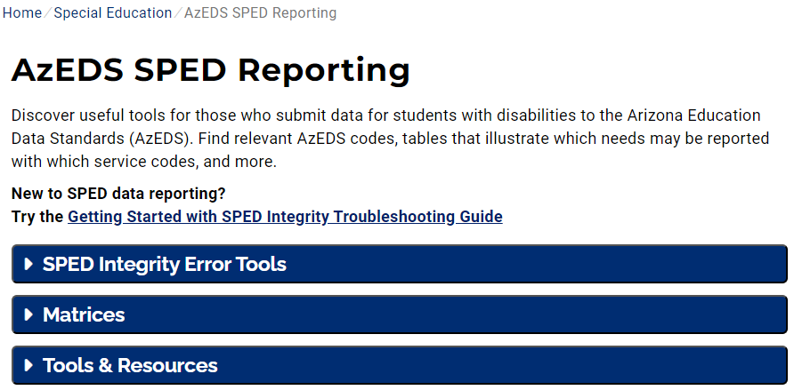
Locate Your Tools (slide 1 of 2)
Bookmark our AzEDS SPED Reporting web page
This page includes our SPED Integrity Error Tools, helpful matrices for concurrent reporting issues, and other resources for navigating your SPED reporting for AzEDS, including the Getting Started with SPED Integrity Troubleshooting Guide.

Slide 18
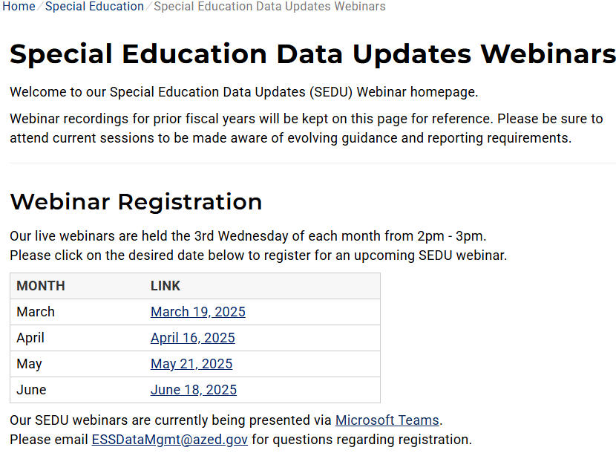
Locate Your Tools (slide 2 of 2)
Review our past Special Education Data Updates
This page includes links to past SEDU presentations. Easily navigate to your desired subject or integrity code using the provided chapter links in each video.
Please visit our AzEDS SPED Reporting web page for more assistance troubleshooting integrity errors.

Slide 19
Identify Your Errors (slide 1 of 2)
Check your SPED72 Report in the AzEDS Portal
The SPED72 report will show all students reported to AzEDS with SPED needs and/or SPED Program participation, ELL participation, and whether they have passed FED SPED and State SPED integrity.
Please visit our AzEDS SPED Reporting web page for more assistance troubleshooting integrity errors.

Slide 20
Identify Your Errors (slide 2 of 2)
Check your INTEG15 Report in the AzEDS Portal
The INTEG15 report displays a post-integrity list of student data related to membership and their integrity status results. Drill down using the filters to identify students at a specific site (optional), Integrity Status as ‘Failed,’ and Integrity Category of ‘SPED’ and ‘Fed SPED.’
Please visit our AzEDS SPED Reporting web page for more assistance troubleshooting integrity errors.

Slide 21
Integrity Error -40087
SPED Preschool Students must be reported with three Preschool Outcome Assessments upon entry. Please refer to the ESS Preschool Outcomes Reporting Guidance document.
1,966 instances as of March 10
Coordinate with PS teams, review Preschool Outcomes Reporting Guidance, contact ADE’s Early Childhood SPED team, and review SPED11 and SPED12 reports.
Please visit our AzEDS SPED Reporting web page for more assistance troubleshooting integrity errors.

Slide 22
Integrity Error -40088
SPED Preschool Students must be reported with three Preschool Outcome Assessments upon exit.
Please refer to the ESS Preschool Outcomes Reporting Guidance document.
476 instances as of March 10
Coordinate with PS teams, review Preschool Outcomes Reporting Guidance, contact ADE’s Early Childhood SPED team, and review SPED11 and SPED12 reports.
Please visit our AzEDS SPED Reporting web page for more assistance troubleshooting integrity errors.

Slide 23
Integrity Error -40089
SPED Preschool Student Exit Preschool Outcome Assessments must indicate if progress was made.
16 instances as of March 10
Coordinate with PS teams, review Preschool Outcomes Reporting Guidance, contact ADE’s Early Childhood SPED team, and review SPED11 and SPED12 reports.
Please visit our AzEDS SPED Reporting web page for more assistance troubleshooting integrity errors.

Slide 24
Q&A
Special Education Data Updates

Slide 25
Thank You
ADEConnect Support
(602) 542-7378
ESS Data Management Inbox
(602) 542-3962
Subscribe to stay informed:
Data Management Alerts
Data Management Vimeo Channel
Next SEDU Webinar: April 16, 2025

